Slide 1

Power EnJoy
Electric car sharing system
01/03/2017

Slide 2
Results of requirements analysis

Slide 3
Actors involved
A person not registered to Power EnJoy or not logged into the system
PERSON
EMPLOYEE
A person registered to Power EnJoy and logged in
An employee responsible for the car retrieval
USERS

Slide 4
Relevant concepts
POWER GRID STATION
Electric power supplier for recharging the cars
POWER ENJOY CAR
Electric powered vehicles owned by PowerEnJoy.
SAFE AREA
Public car parks, specific areas of the city and private PowerEnJoy car parks

Slide 5
States of a car
the car was in a safe area
AVAILABLE
car reservation
car retrieval
reservation expires
NOT AVAILABLE
RESERVED
the car was in a non-safe area or “battery distance constraint”
safe area parking after 1 hour
parking before 1h
unlocking and ignition
DISLOCATED
RUNNING
non-safe area parking after 1 hour or ”battery distance constraint”
Notes:
C1*: the car is parked more than 3 km away from a power grid or having less than 20% of its battery.

Slide 6
Car retrieval
What if a user parks in a non-safe area?
a set of employees has access to a dedicated application
when a car enters the "dislocated" state, a notification is broadcast containing the specifics for the retrieval
an employee accepts the retrieval request
he/she brings the car back to a safe area, recharging it if needed

Slide 7
Extra fees and discounts
Only the highest percentage discount is applied
No discounts is applied if any extra fee is charged
Extra charges are applied cumulatively
RATIONALE: we want to discourage negative behavior from the users and to prevent the users from abusing the discount system

Slide 8
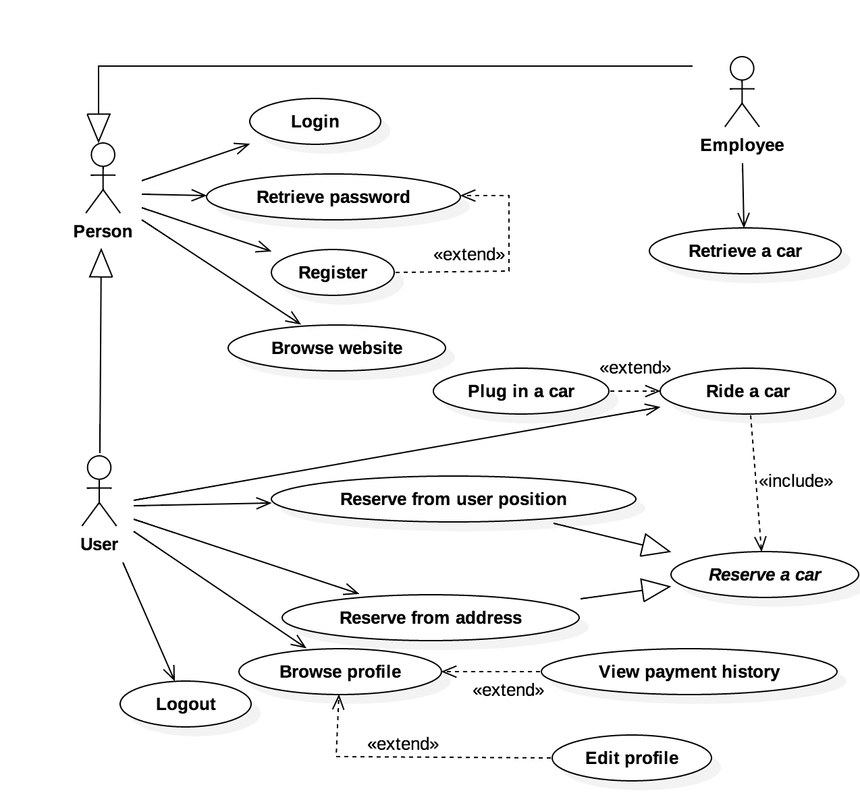
Functionalities overview

Slide 9
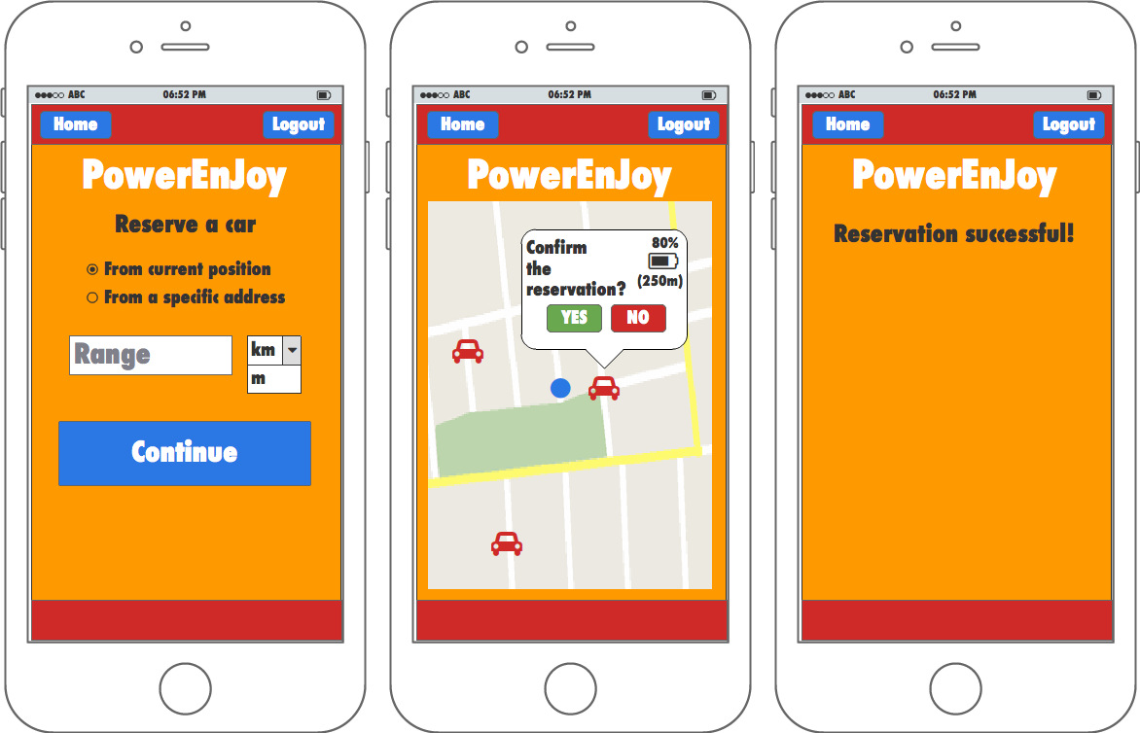
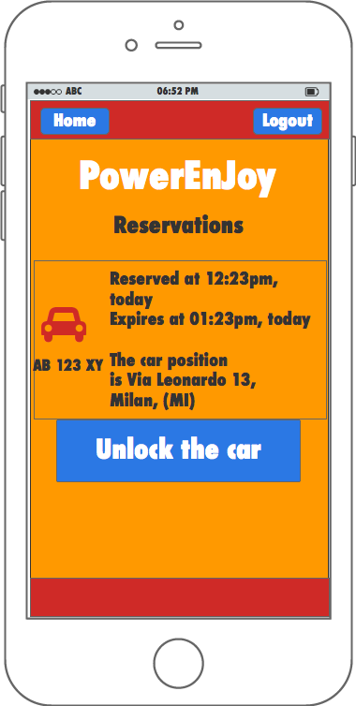
Look and feel

Slide 10
Let’s talk about software design…

Slide 11
What does our software system need?
Car software system
Different software components need to exchange information
Their interaction is largely event-centric:
Notifications about dislocated cars
State-change notifications from cars to the server side
Notification to the user about his/her ride
User
application
Employee application
Server side system

Slide 12
Event driven architecture
Server side logic
User
application
Dispatcher
Employee application
Car software system

Slide 13
A closer look at the server side

Slide 14
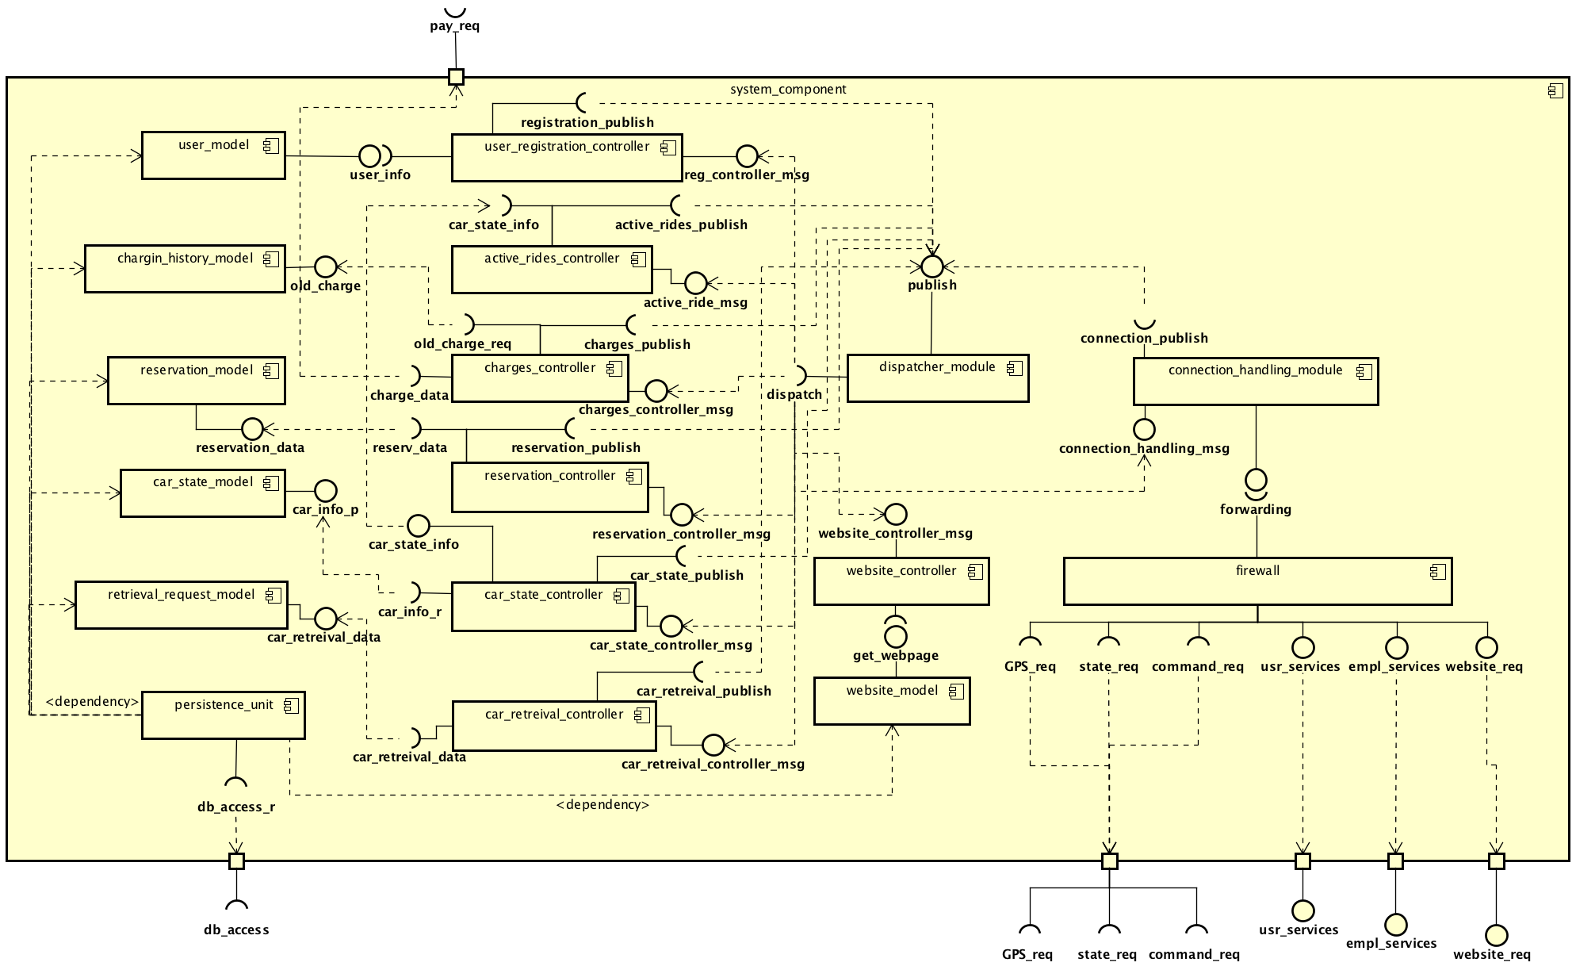
DATA MODEL
CONTROL LOGIC
DISPATCHER

Slide 15
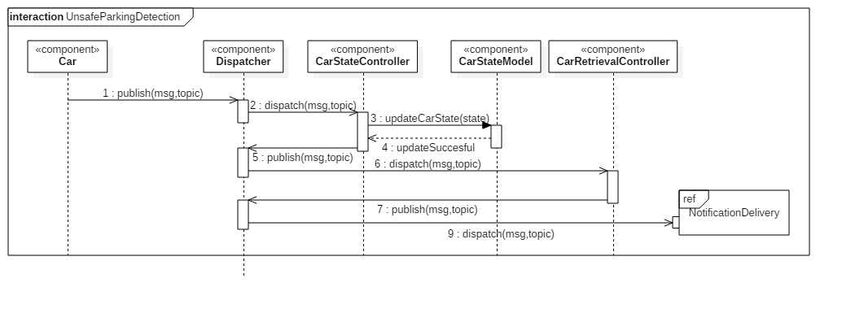
Interaction example
Unsafe parking detection

Slide 16
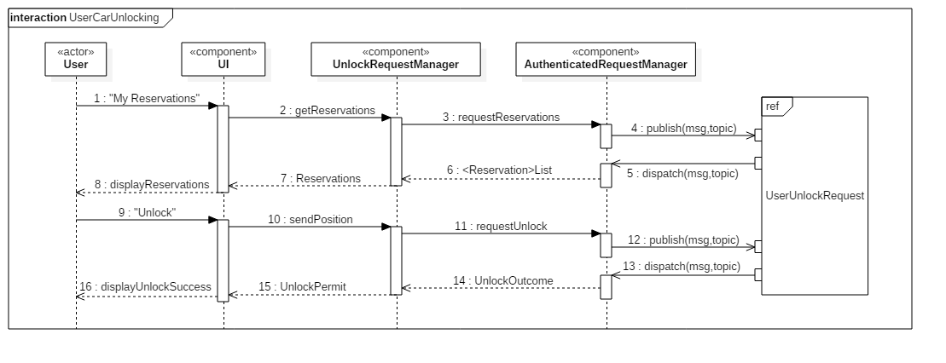
Interaction example
User car unlocking

Slide 17

From design to implementation
A stable and well known framework for enterprise applications development
Supports event-driven architecture (Java Message Service)
Helps to deal with scalability and availability issues

Slide 18



For a better user experience
Dedicated application for all the main operating systems

Slide 19
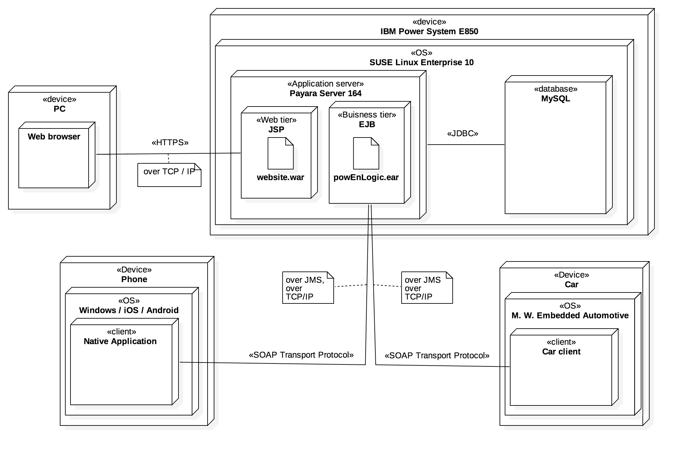
The resulting deployment

Slide 20
A few words on testing
For integration testing we adopted a bottom-up testing strategy
This will allow us to perform integration testing as soon as the involved components have been tested at the unit level, since the development process will also follow bottom-up approach
A thread-based strategy has been considered, but we opted out of it due to the multi-functional nature of many components

Slide 21
Thank you for the attention
Francesco Peverelli, Federico Reppucci

